Slide 1

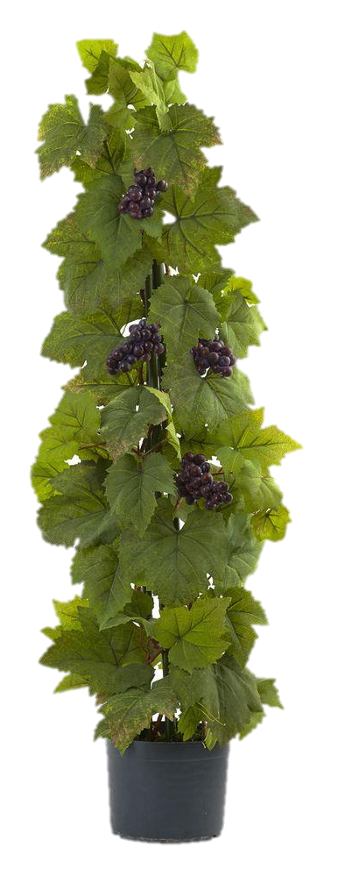

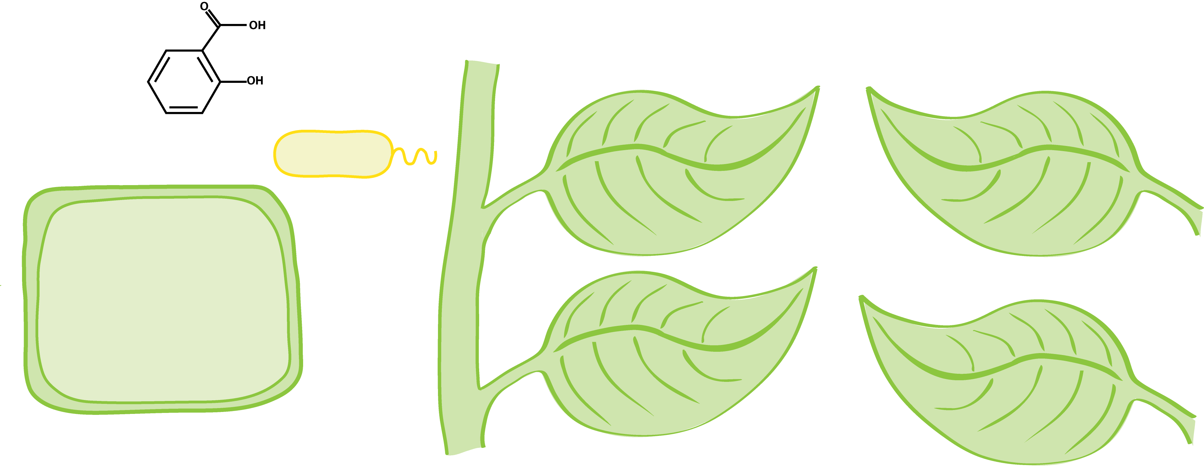
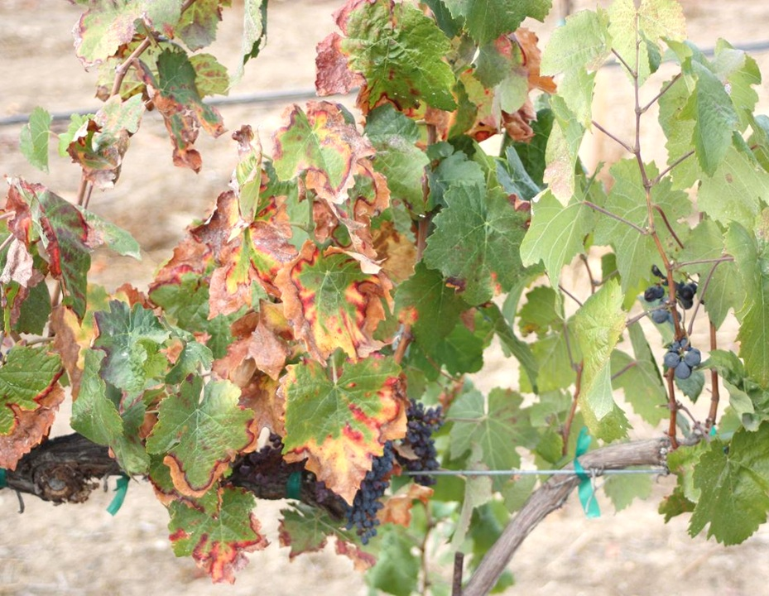
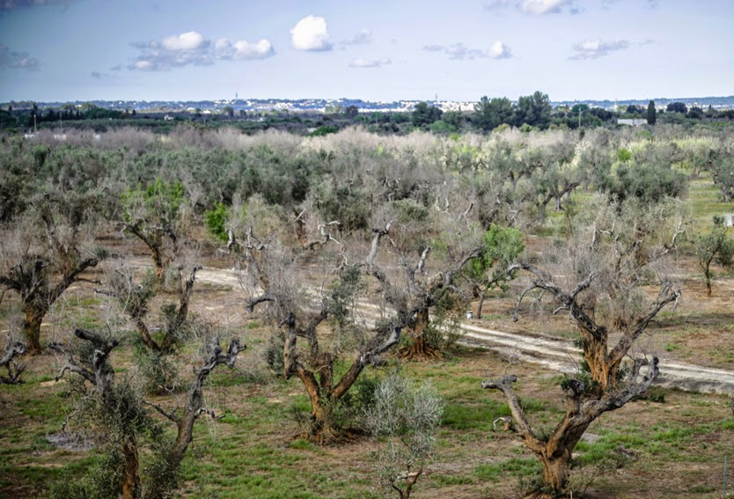
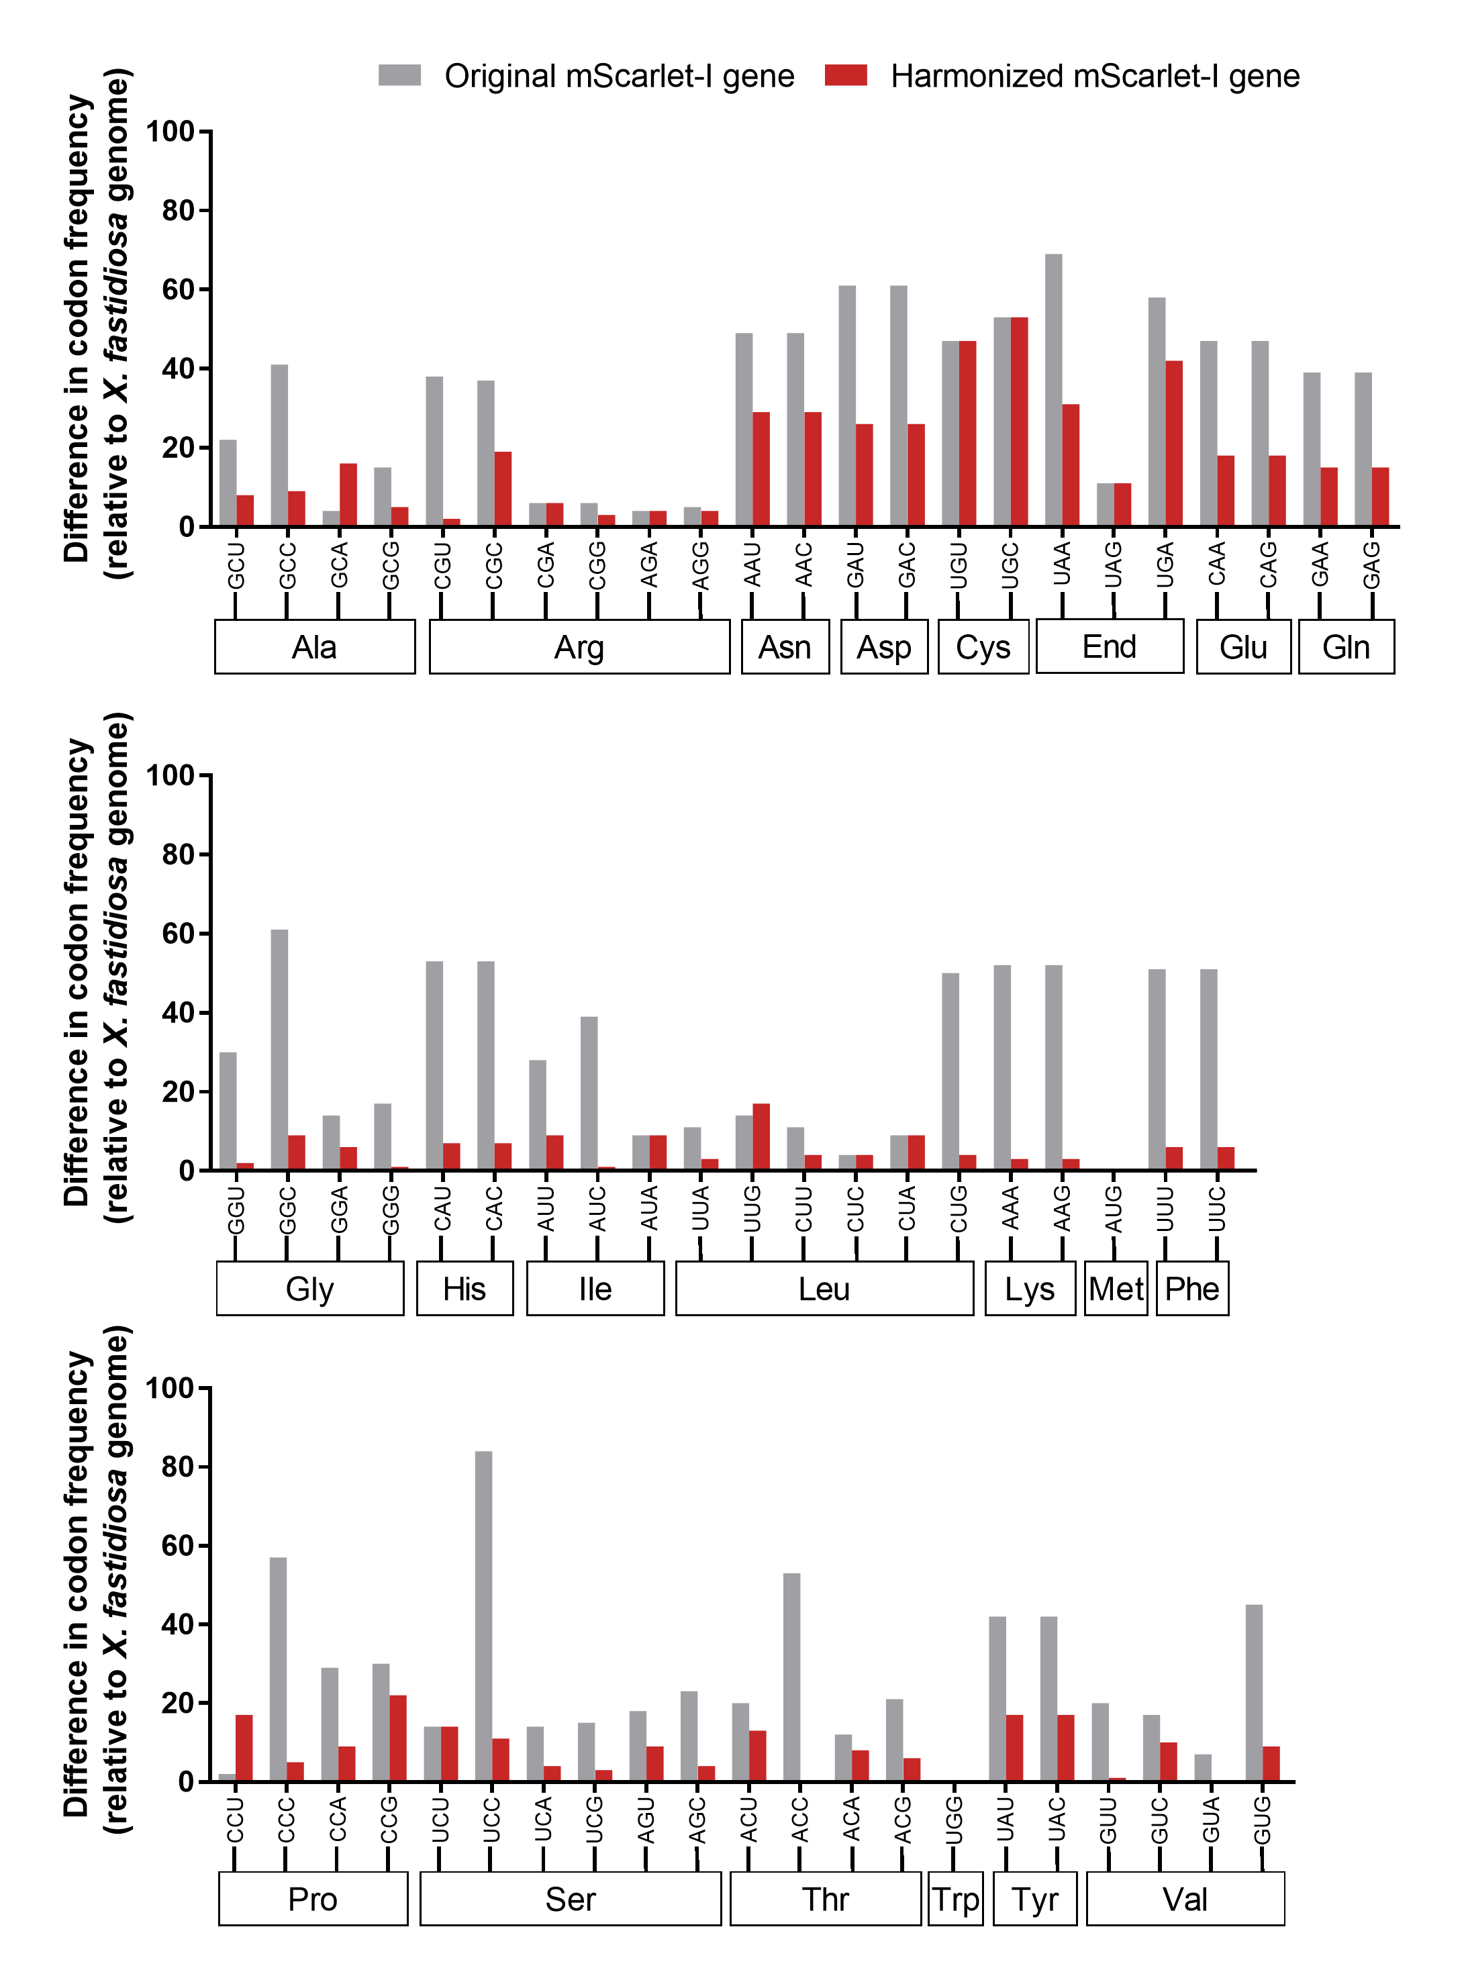
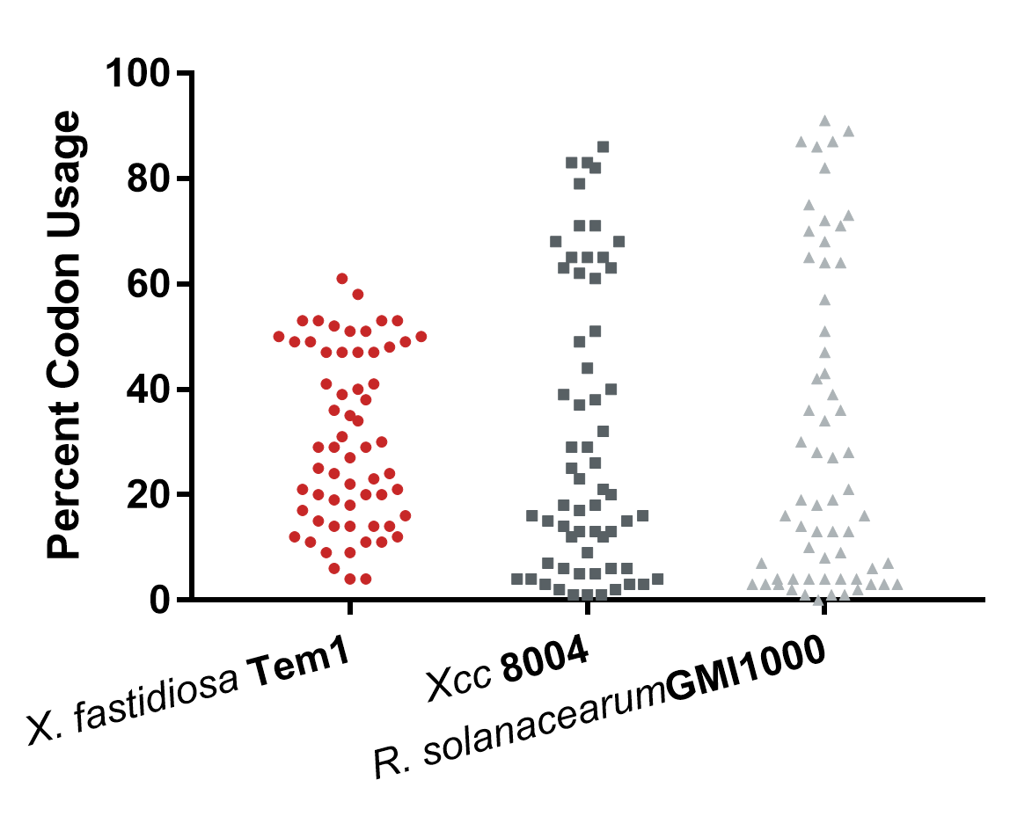
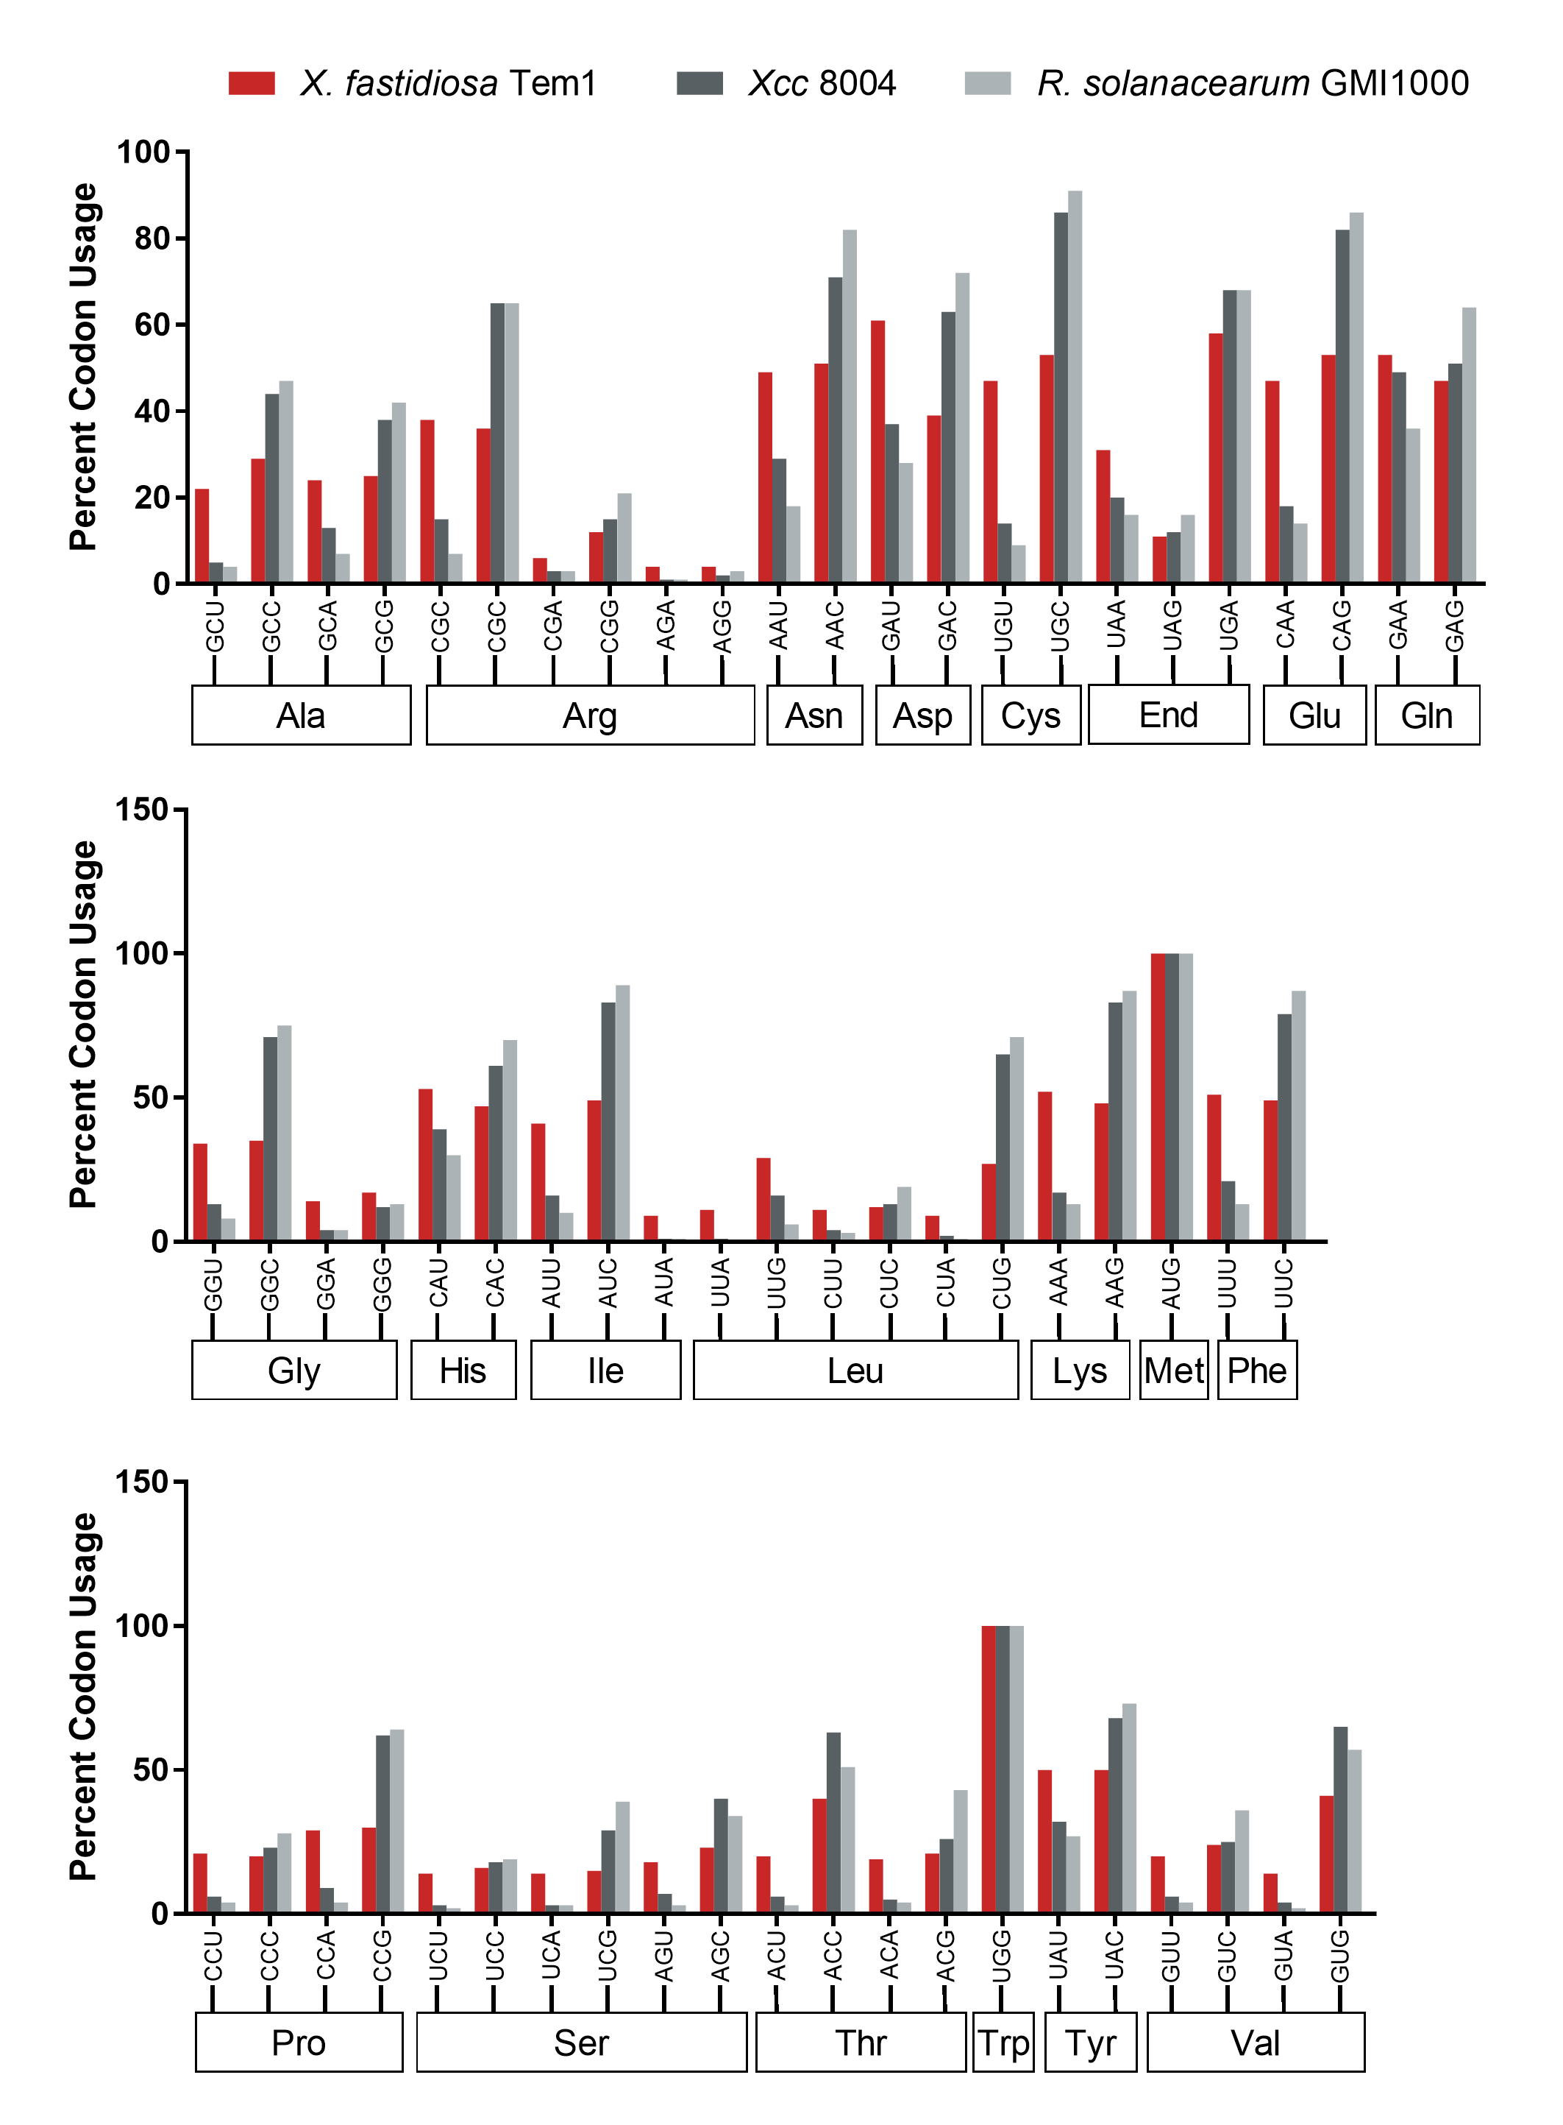





Effects of codon bias on expression of heterologous genes in Xylella fastidiosa
Tiffany Lowe-Power and Steven Lindow
Plant and Microbial Biology, University of California Berkeley
Xylella fastidiosa: an bacterial xylem pathogen
Methods: Harmonize mScarlet-I and mNeonGreen genes to X. fastidiosa codon usage
Xylella fastidiosa
Important diseases: Pierce’s disease of grapevine, olive quick decline syndrome, citrus variegated chlorosis
Slow, progressive xylem pathogen
Vector-borne by xylem-feeding insects (leafhoppers & spittlebugs)
Fig 2. Codon harmonization of mScarlet-I gene. Engineered fluorescent proteins with improved brightness (mScarlet-I and mNeonGreen) were selected for codon harmonization and expression in X. fastidiosa. Difference in codon usage frequency for original allele and codon-optimized allele is shown for mScarlet-I. Similar results achieved for mNeonGreen
Pierce’s disease of Grapevines (UC Riverside)
Olive trees in Puglia (Paride De Carlo)
Goal: Optimize transcriptional reporters for X. fastidiosa
Transcriptional fusions where promoters of interest drive expression of fluorescent protein genes are powerful tools for studying bacterial behavior in vitro and in host contexts. However, attempts to use fluorescent protein reporters in the fastidious bacterium X. fastidiosa have been unsuccessful.
Because previous attempts have used fluorescent protein genes with codon usage optimal for E. coli, we hypothesized that codon-harmonization may improve expression of fluorescent protein genes in X. fastidiosa.
X. fastidiosa genome has remarkably low codon bias
Fig 1. X. fastidiosa genome has low codon bias. In most organisms, genes exhibit bias in codon usage that reflects availability of cognate tRNAs. Codon usage mismatch between a genome and a heterologous gene can reduce protein expression by slowing translation efficiency, especially when rare codons are over-used.
Relevant reading: Bindels et al. 2017. mScarlet: a bright monomeric red fluorescent protein for cellular imaging. Nat. Methods
Shaner et al. 2013. A bright monomeric green fluorescent protein derived from Branchiostoma lanceolatum. Nat. Methods
Overall codon usage for amino acids with 2+ codons
Ongoing work: Test PhxfA::mScarlet-I and PhxfA::mNeonGreen reporters
Fluorescent XfDSF quorum sensing sensor:
P_{hxfA}
mScarlet-I ^{Xff}
Fig 3. Expression of mScarlet-I and mNeonGreen will be tested in X. fastidiosa. Expression will be driven by the quorum sensing dependent promoter upstream of the hxfA hemagglutinin gene.
pBBR1-MCS5
P_{hxfA}
mNeonGreen ^{Xff}
pBBR1-MCS5
Acknowledgements
Contact
tlowepower@berkeley.edu
@tlowepower
Relevant reading: Smolka et al. 2003. Proteome analysis of the plant pathogen Xylella fastidiosa reveals major cellular and extracellular proteins and a peculiar codon bias distribution. Proteomics
Tiffany Lowe-Power is funded by
USDA NIFA Postdoctoral fellowship #15148
Tiffany M. Lowe-Power

